Slide 1
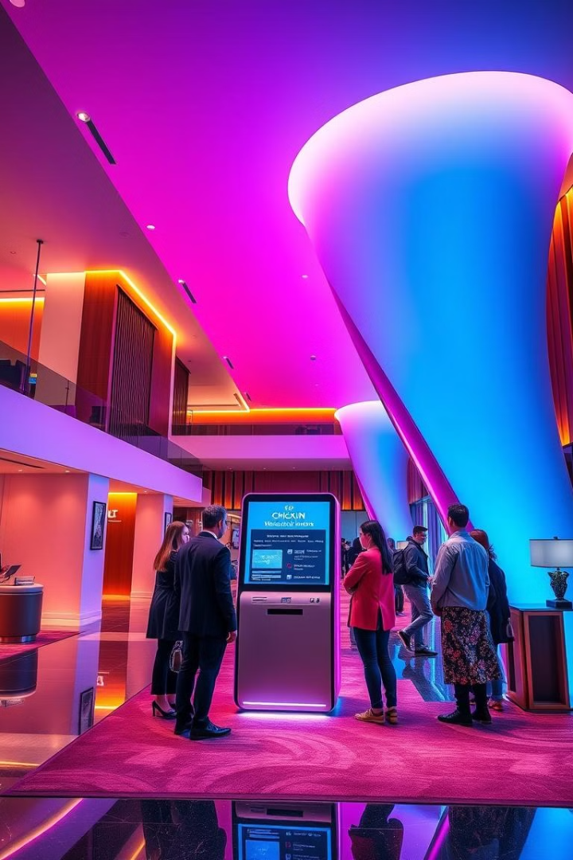
Hotel Management System: A Java-Based Solution
This presentation explores a Java-based Hotel Management System, outlining its feasibility, societal relevance, and innovative features.

Slide 2
Project Feasibility Analysis
Technical Feasibility
Economic Feasibility
Java's robust libraries and object-oriented nature facilitate efficient development and maintainability.
The system addresses a critical need for hotels, potentially generating revenue through improved operational efficiency.

Slide 3

Societal Relevance
1
Enhanced Guest Experience
2
Improved Staff Efficiency
Streamlined check-in/out processes, personalized services, and online booking capabilities.
Automated tasks and streamlined workflows allow hotel staff to focus on guest interactions and service excellence.
3
Sustainable Operations
The system can incorporate features like energy-saving mechanisms and paperless communication, promoting environmental sustainability.

Slide 4




Novelty of the Project
Real-Time Data Analytics
Integration with Smart Technologies
AI-Powered Chatbots
The system gathers and analyzes data to optimize pricing, resource allocation, and marketing strategies.
The system provides 24/7 customer support through AI-powered chatbots, enhancing guest satisfaction.
The system can be integrated with smart devices, allowing for automated room control and guest requests.

Slide 5



Operational Feasibility
Seamless Integration
1
The system can be seamlessly integrated with existing hotel infrastructure.
Minimal Disruption
2
Minimizing disruption to hotel operations during implementation.
Maximized Adoption
3
Ensuring user-friendly design for easy adoption by hotel staff and guests.

Slide 6

Conclusion
This Java-based Hotel Management System offers a comprehensive solution for modern hotels, addressing key operational challenges and enhancing guest experiences. Its innovative features, including real-time data analytics, smart technology integration, and AI-powered chatbots, position it as a valuable asset for the hospitality industry.

